Slide 1

Final year
Project presentation
On
5 dof robotic arm

Slide 2
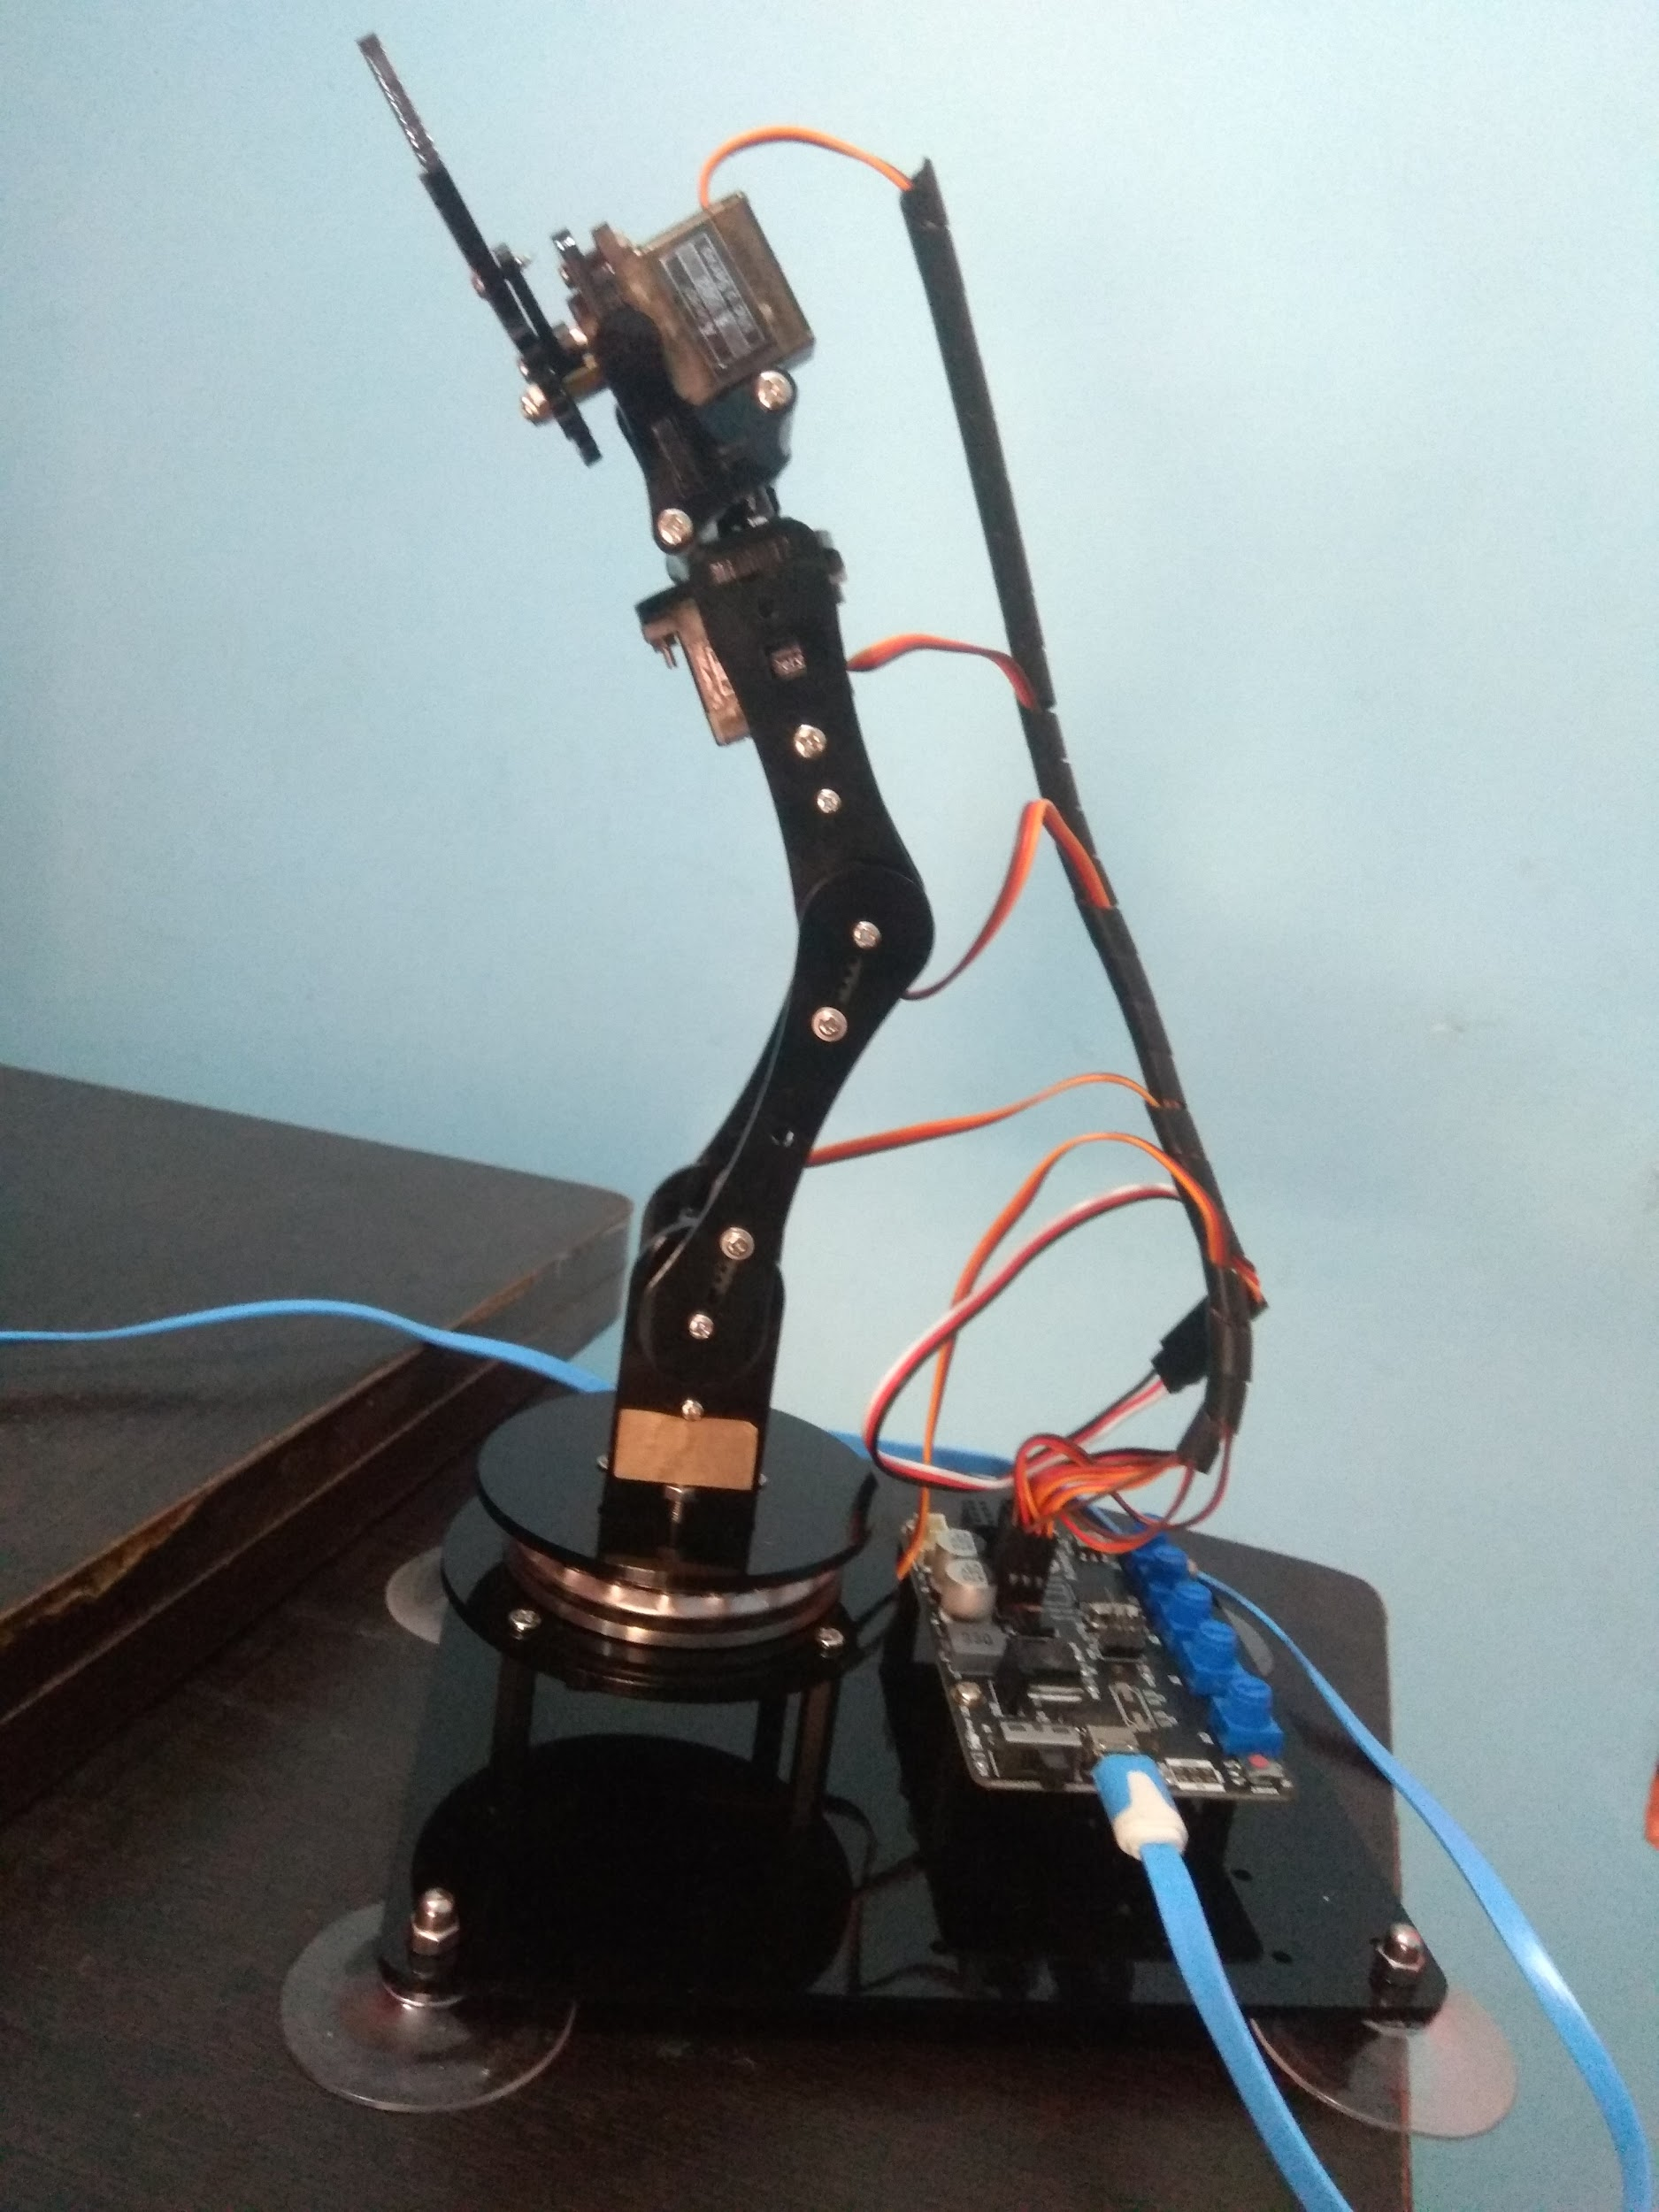
5 dof Robotic arm
NEERAJ KUMAR
TANURAJ TOMAR
RAJA HASSAN
Project supervisor
DR. ABHISHEK SHARMA
Department of Electronics & Communication Engineering
IIMT College of Engineering
Greater Noida U.P-201310

Slide 3
Outline
Introduction
Theory
Components used
Software used
Mechanical configuration
Methodology and working
Conclusion
Result
Reference

Slide 4
Introduction
A robotic arm is a machine that can execute tasks that a human arm can do.
Nowadays, under the progress of science and technology, the most significant difference between the robot arm and a human arm lies in flexibility and strength. That instance, the robotic arm's most significant benefit is that it can generally repeat the same operation without becoming fatigued.

Slide 5
Theory
This robotic arm has five joints, each controlled by a servo motor. Each servo motor has a range of rotation from 0 to 180 degrees.
Servo motor is controlled by the microcontroller delivering pulses. The servo is told where to move by these pulses. Housing, circuit board, non-core motor, gearing, and position detection are all part of the servo motor system.
Servo motor is shown in the following page.
Pulse is mostly responsible for the servo's setting. The servo motor receives an impulse and turns the angle corresponding to the impulse to achieve displacement.

Slide 6
Theory continue
Because the servo motor's duty is to send out pulses, it rotates at an angle every time, causing a matching number of pulses to be sent out.
The pulses received by the servo motor form a response, or a closed loop, in this fashion. The system will be able to tell how many pulses are supplied to the servo motor and how many pulses are received this way.
Setting a servo motor's rotation is a simple task. Simply include the Servo.h header from the Arduino IDE's library, and you're done. Create a Servo object and associate the servo pin with it.

Slide 7
Theory continue
To set the rotation, we call the write() method from the servo object.
servo.write(90);
Pseudo code:
#include <Servo.h>
Servo servo;
// ...setup
servo.attach(servo_pin);
//... changing rotation
servo.write(angle);

Slide 8
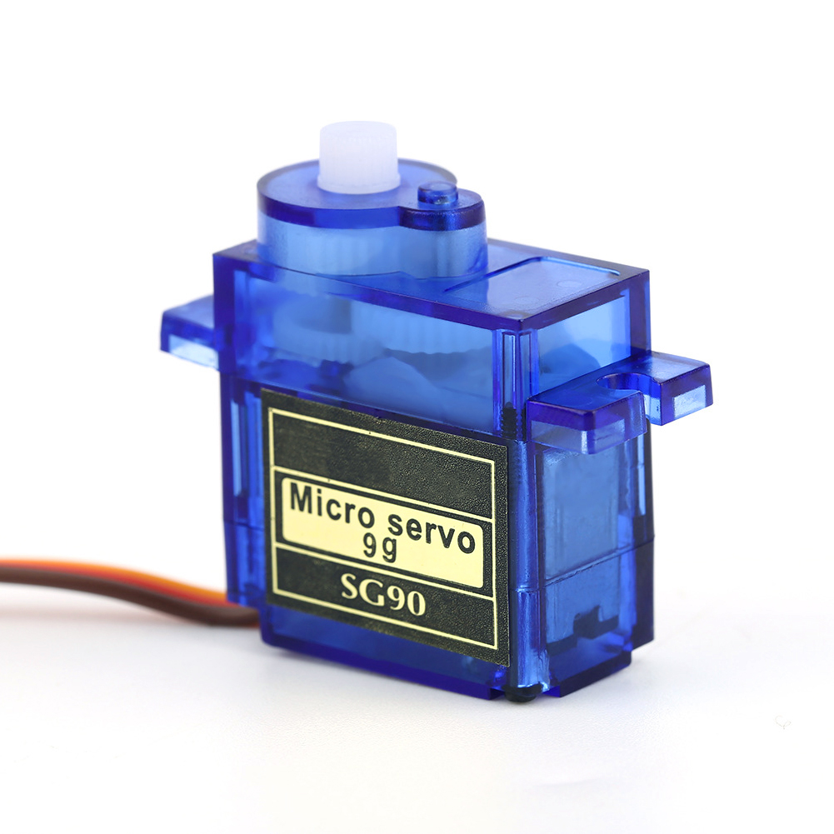
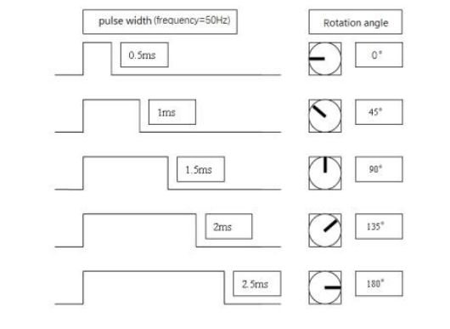
servo motor

Slide 9
Components used
Acrylic plates
nuts, lock nuts, cap nuts, and other machinery parts
Arduino UNO x 1
servo motors x 5
connecting wires
USB cable
OLED display x 1
Potentiometers x 5
HC 05 Bluetooth module x 1
18650 battery x 2

Slide 10
Software used
Arduino IDE
Processing development environment (for desktop controller app)
Android studio (for android controller)

Slide 11
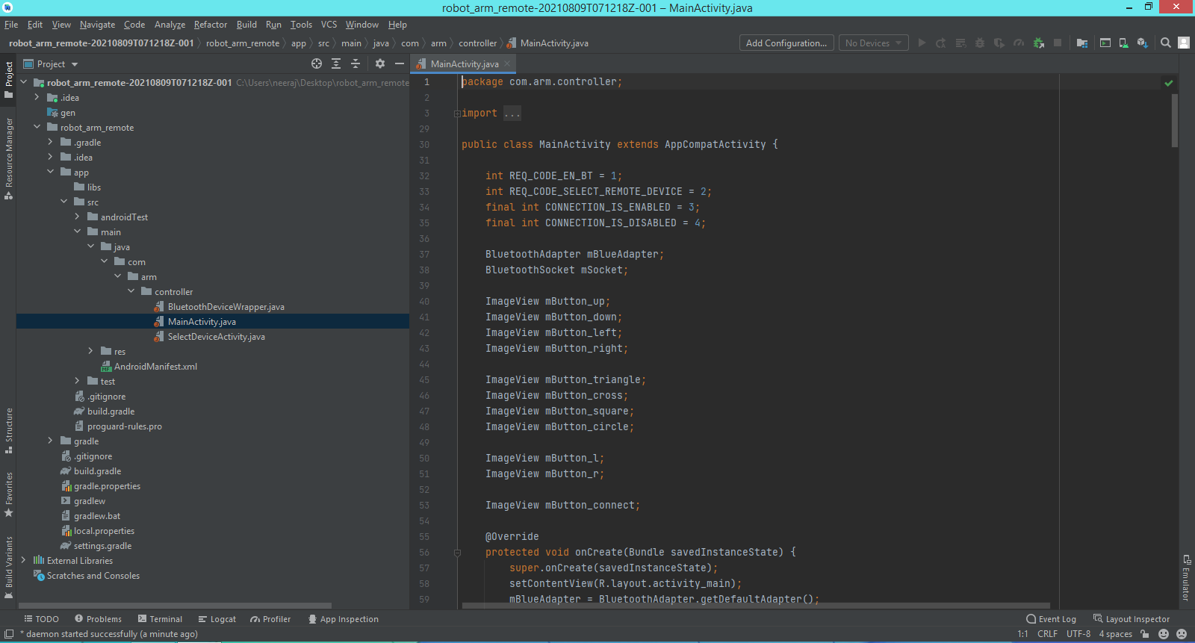

Slide 12
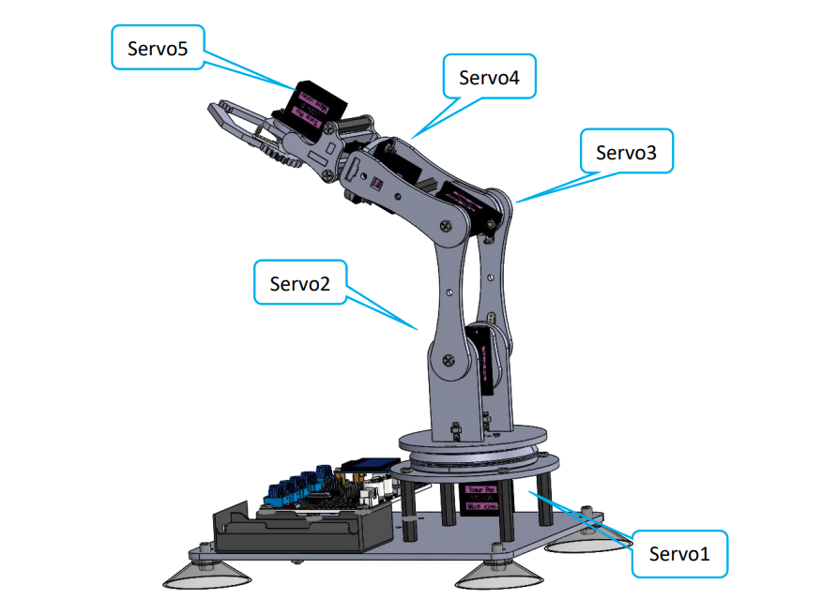
Mechanical config
Wrist
Gripper
Actuators | Joints | Arduino pwm pins
Servo 1 | base | 9
Servo 2 | shoulder | 6
Servo 3 | elbow | 5
Servo 4 | wrist | 3
Servo 5 | gripper | 11
Elbow
Shoulder
Base
Table.1. Servo config with arduino pwm pins

Slide 13
Methodology and working
Throughout this project, the developed robotic arm can be controlled in two modes.
Controlling via potentiometers
Controlling via android or desktop application
When using the potentiometer:
The diagram on the following page describes how the microcontroller reads the value in the range 0 to 1023 from the potentiometer connected at analog pins. Further this read value is mapped in the range of 0 to 180 because maximum rotation for the servo is 180 degree.
Finally microcontroller updates the rotation of the servo.

Slide 14
Servo 1
Servo 2
Servo 3
Servo 4
Servo 5
servo.write(angle);
angle = map(value, 0, 1023, 0, 180);
Arduino UNO
value = analogRead();
reads in between 0 - 1023
Potentiometers

Slide 15
When using the android application:
We developed an android application which makes communication link with arduino via bluetooth connectivity. For this to happen we installed a bluetooth device called HC 05 bluetooth module to the arduino.
Microcontroller manages a set of fake buttons (or virtual buttons) which can be pressed and release by the android application. This application only send the ascii characters to the microcontroller. For example sending the ascii character ‘a’ to arduino will press the btn_1 which cause the arm to rotate left and another ‘a’ will release the btn_1 which stops the arm from rotating left.
Following page shows you the diagram and a table which lists out the action for each used ascii character.

Slide 16
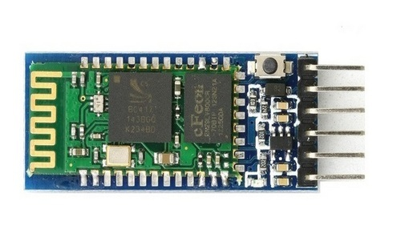
On button pressed
Rotate left
Rotate right
Open shoulder
Close shoulder
Open elbow
Close ebow
Wrist right
Open grip
Close grip
Wrist left
Virtual buttons
btn 0
btn 1
btn 2
btn 8
btn 3
btn 4
btn 5
btn 6
btn 7
btn 9
PROCESS COMMANDS AND UPDATE THE BUTTON STATE
Arduino UNO
Serial communication
GUI controller
Baud rate 9600
Android app connected to hc 05
HC 05

Slide 17
ASCII char | Action on button down | Affected Virtual Button
a | Rotate left | btn 0
d | Rotate right | btn 1
k | Open shoulder | btn 2
i | Close shoulder | btn 3
s | Open elbow | btn 4
w | Close elbow | btn 5
j | Wrist left | btn 6
l | Wrist right | btn 7
q | Open grip | btn 8
e | Close grip | btn 9

Slide 18
Conclusion
This proposed project is an overview of how we may use servo motors to construct joints for a robotic arm and operate it by sending signals to an Arduino UNO via serial communication.
This initiative has the potential to grow in the future. Servo motors with better angle placement, greater torque, and broader angle movement produce superior outcomes. Encoder sensors can read the locations of servo motors to improve angle positioning. To prevent shaking while servo motors are rotating, better and stronger materials can be utilized in the body. Servo motors with larger torques can be used to lift heavy loads. This is a low-budget, low-cost project whose primary goal is to operate a system using an Android application and an HC 05 bluetooth module.

Slide 19
Result
Throughout this project, a 5 degree of freedom (DOF) robotic arm is designed that can be operated via developed android and desktop applications.
Following figures shows the developed robotic arm and controlling softwares.

Slide 20
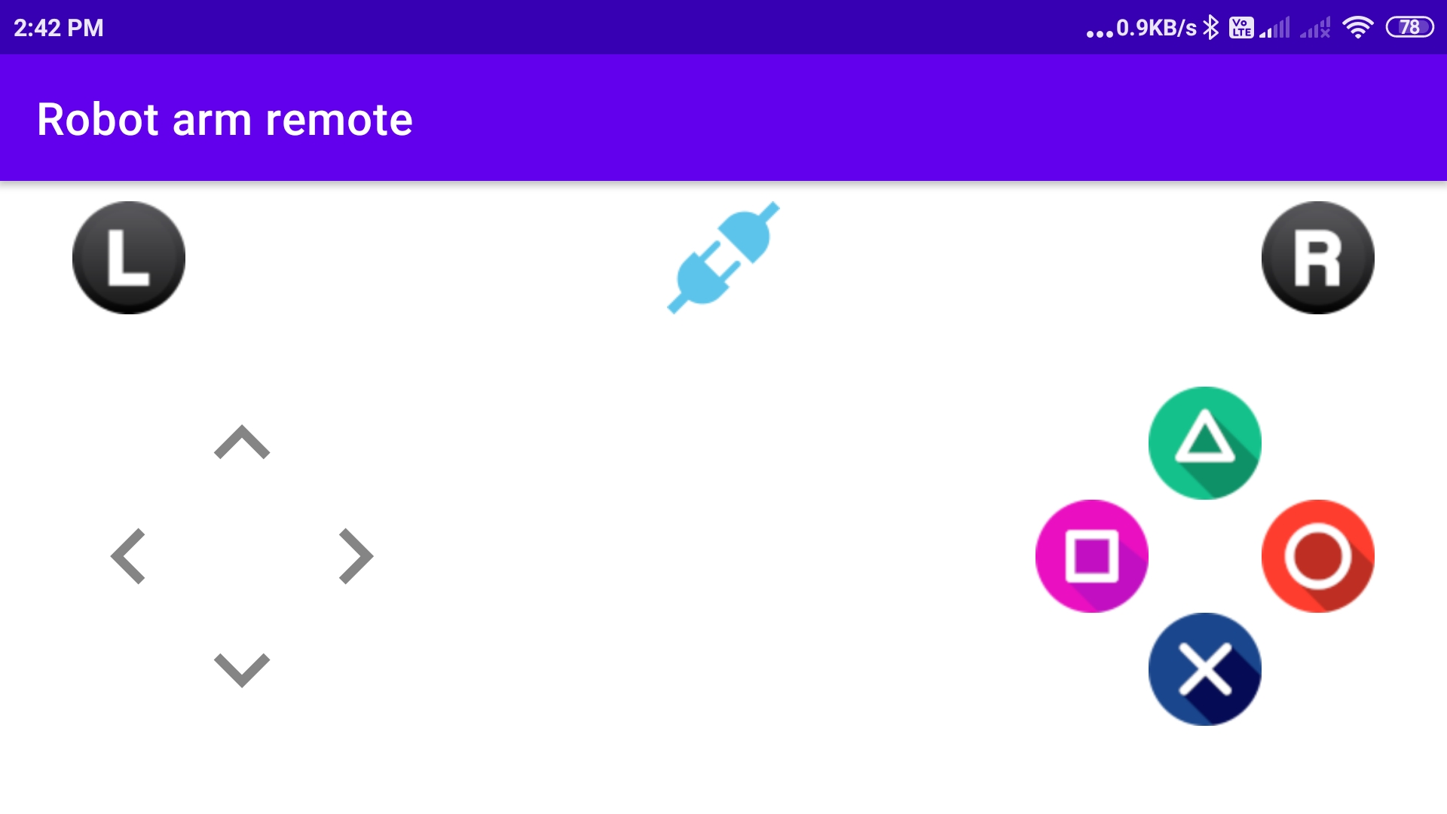
Android application to control the arm

Slide 21
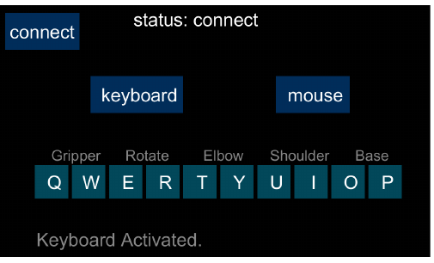
Desktop application to control the arm

Slide 22
References
https://www.arduino.cc/reference/en/
https://processing.org/reference/
https://developer.android.com/docs
and some other websites on the internet.
Arduino ™ + Android ™ Projects for the Evil Genius (Book)

Slide 23
Thank
You...

